Slide 1
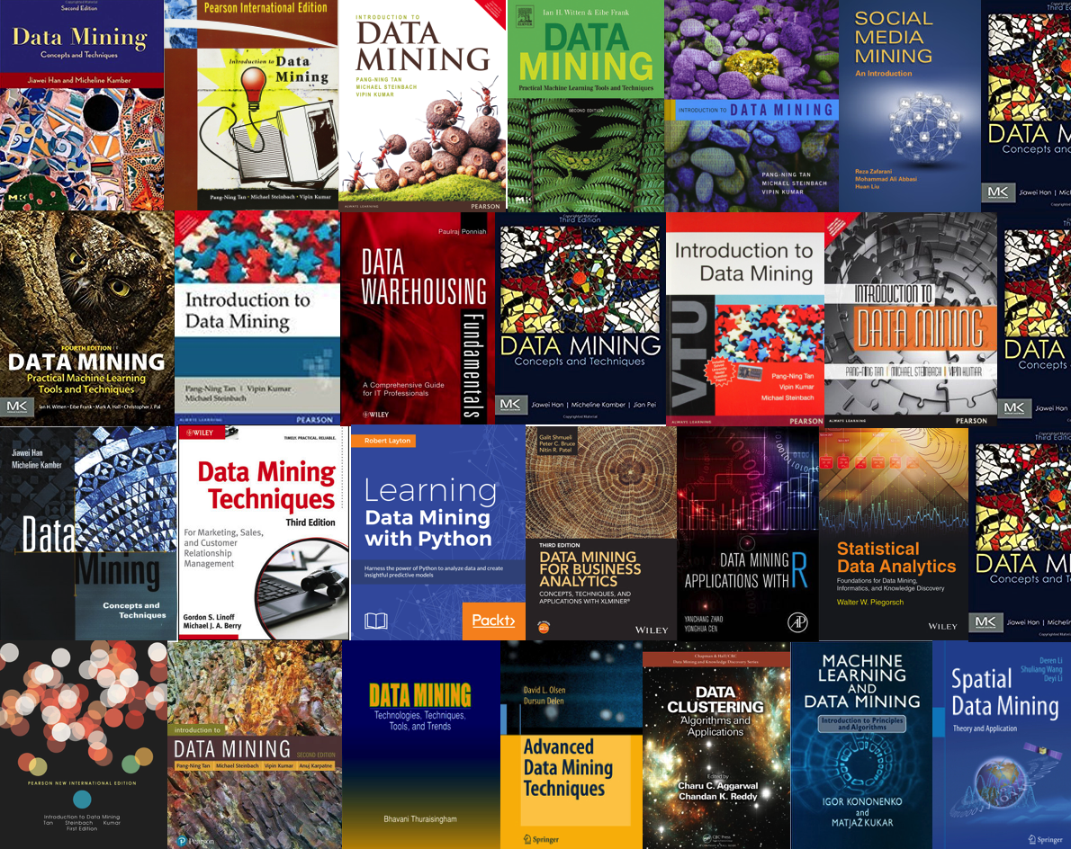
CSE 40647/60647
“Data Science” Fall 2017:
Introduction to Data Mining

Slide 2
Chapter 1. Introduction
Meng Jiang
CSE 40647/60647 Data Science Fall 2017
Introduction to Data Mining

Slide 3
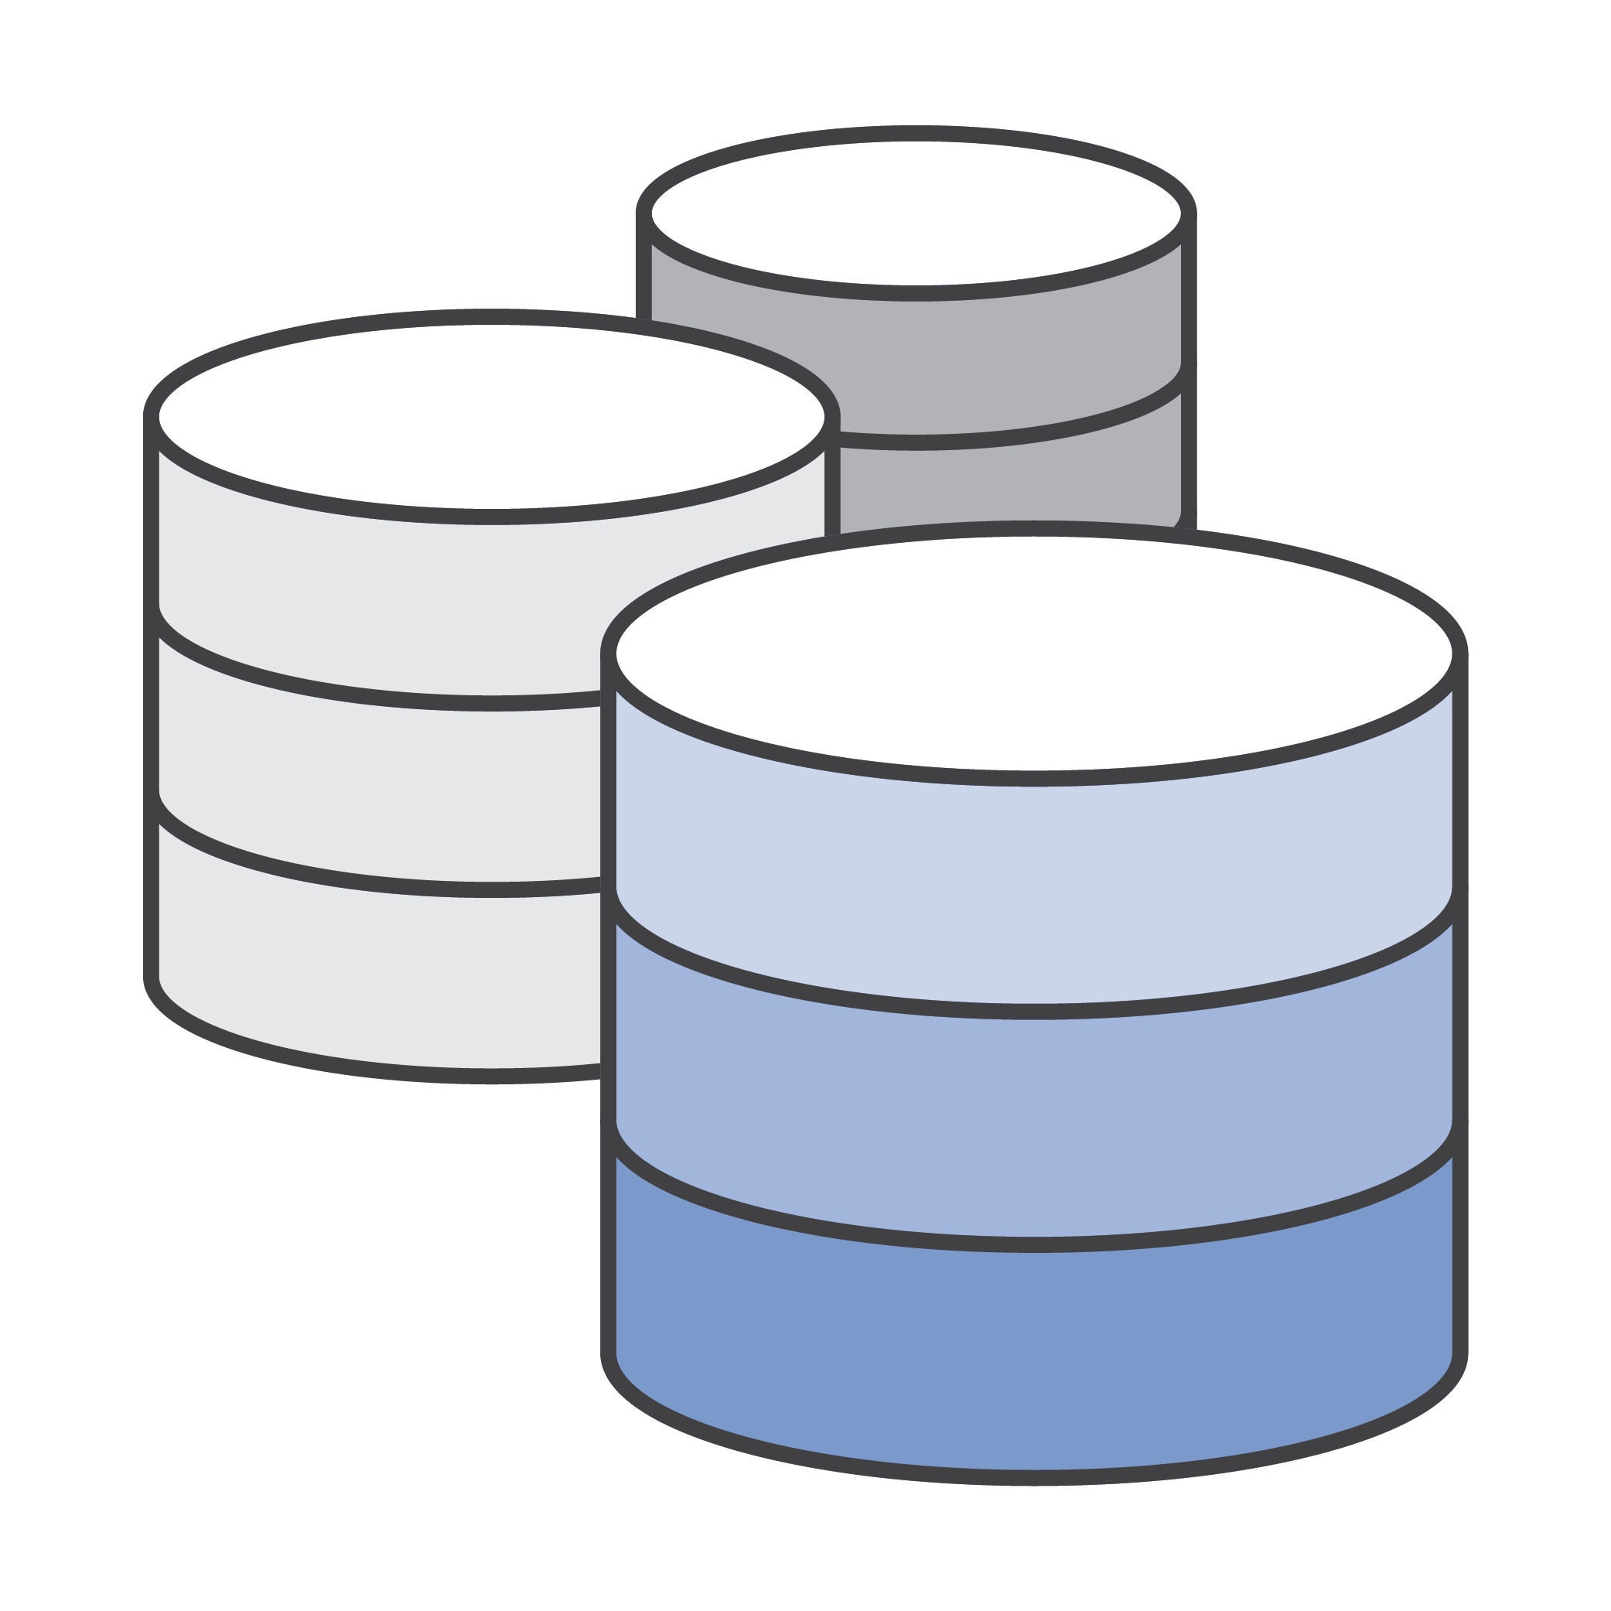


Course History
Taught in the University of Illinois at Urbana-Champaign, Summer 2017
Course project: Data Science for Data Science
Can we mine data-science publications with data-driven technologies for data-scientific knowledge discover and technology exploration?
data
method
problem

Slide 4
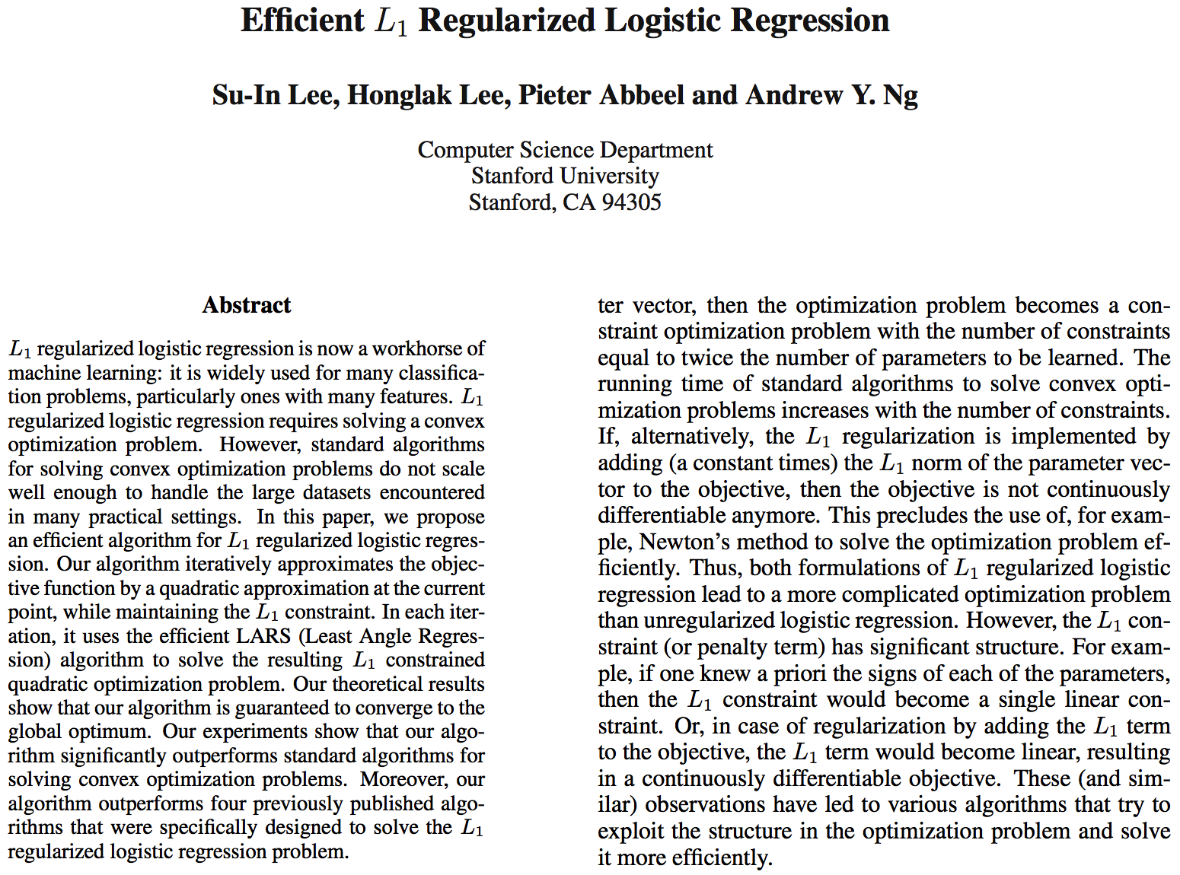
Example: Knowledge Discovery
AAAI’06
 | Dataset | Problem | Method
Paper-AAAI’06 |  | convex optimization | logistic regression; L1 regularization

Slide 5
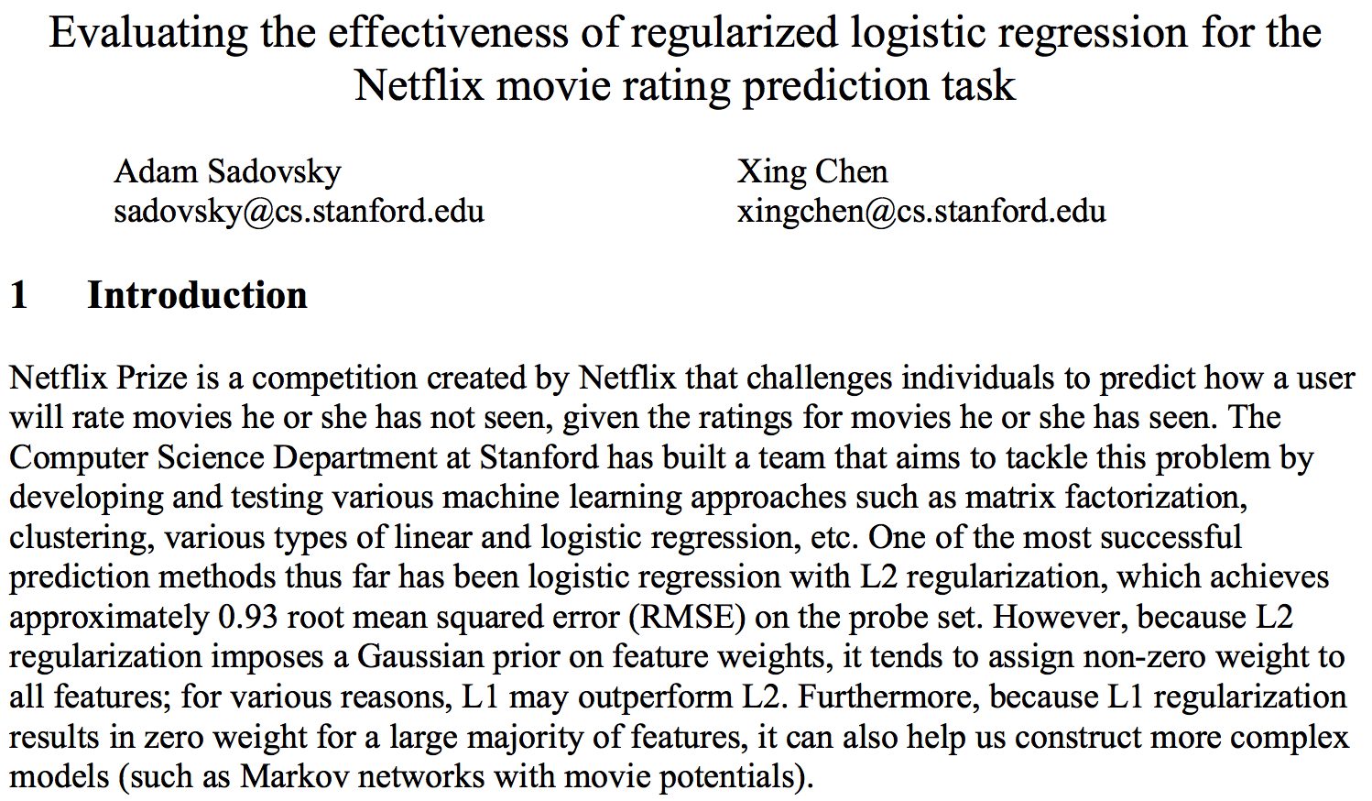
Example: Knowledge Discovery
CS229
 | Dataset | Problem | Method
Paper-AAAI’06 |  | convex optimization | logistic regression; L1 regularization
Paper-CS229 | netflix | rating prediction | logistic regression; L1 regularization; L2 regularization; matrix factorization

Slide 6
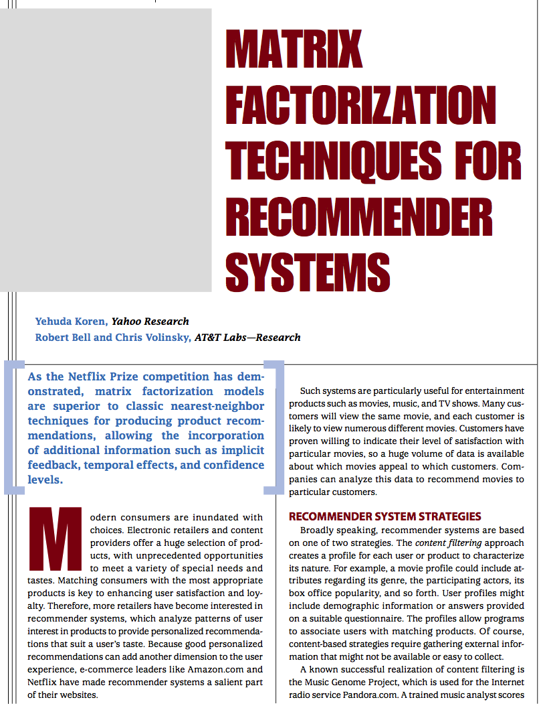
Example: Knowledge Discovery
Computer’09
 | Dataset | Problem | Method
Paper-AAAI’06 |  | convex optimization | logistic regression; L1 regularization
Paper-CS229 | netflix | rating prediction | logistic regression; L1 regularization; L2 regularization; matrix factorization
Paper-Computer’09 | netflix | rating prediction | matrix factorization; regularization

Slide 7
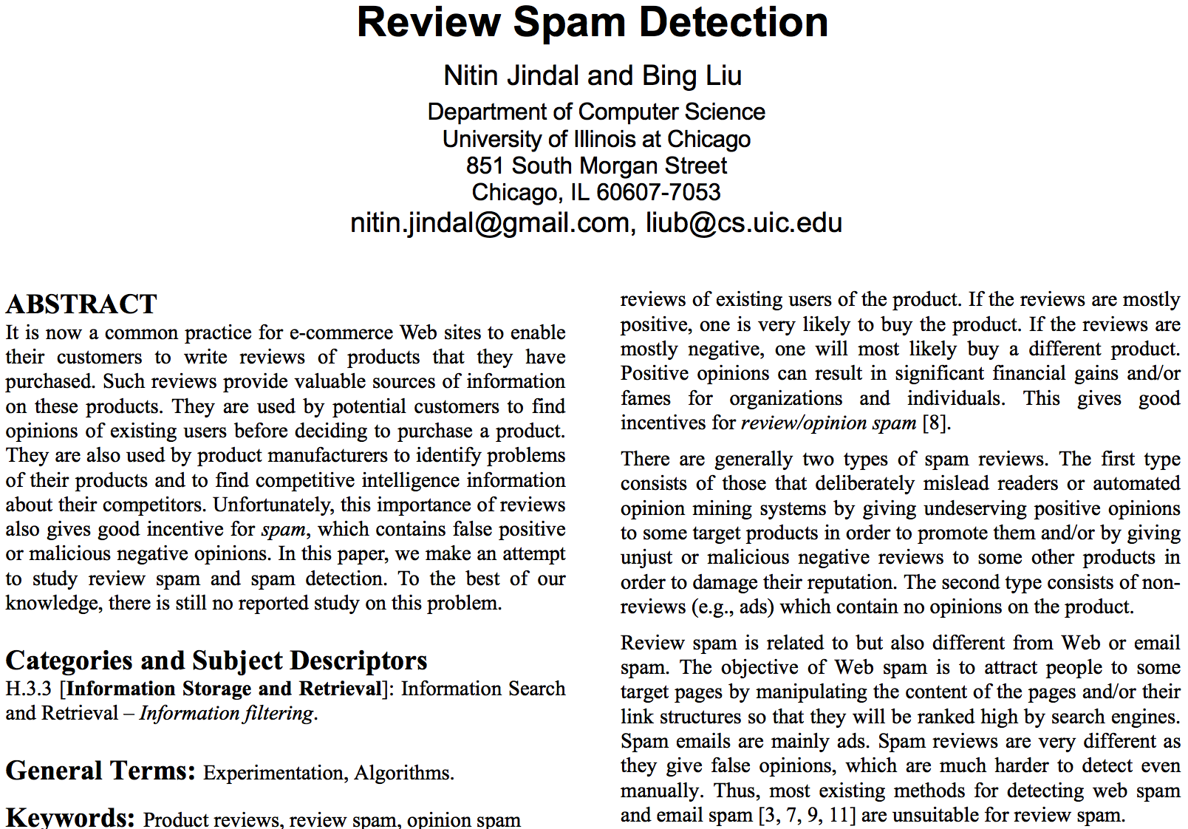
Example: Knowledge Discovery
WWW’07
 | Dataset | Problem | Method
Paper-AAAI’06 |  | convex optimization | logistic regression; L1 regularization
Paper-CS229 | netflix | rating prediction | logistic regression; L1 regularization; L2 regularization; matrix factorization
Paper-Computer’09 | netflix | rating prediction | matrix factorization; regularization
Paper-WWW’07 | amazon | review spam detection; classification | logistic regression

Slide 8
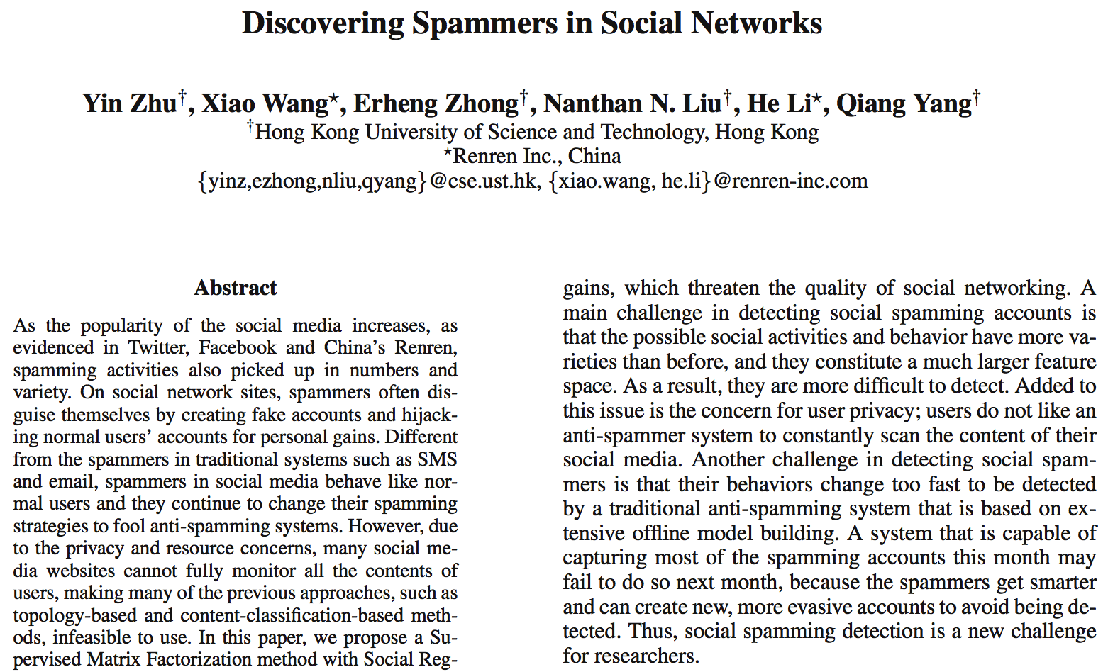
Example: Technology Exploration
AAAI’12
 | Dataset | Problem | Method
Paper-AAAI’06 |  | convex optimization | logistic regression; L1 regularization
Paper-CS229 | netflix | rating prediction | logistic regression; L1 regularization; L2 regularization; matrix factorization
Paper-Computer’09 | netflix | rating prediction | matrix factorization; regularization
Paper-WWW’07 | amazon | review spam detection; classification | logistic regression
Paper-AAAI’12 | renren | social spam detection; classification | ???

Slide 9
Example: Technology Exploration
AAAI’12
 | Dataset | Problem | Method
Paper-AAAI’06 |  | convex optimization | logistic regression; L1 regularization
Paper-CS229 | netflix | rating prediction | logistic regression; L1 regularization; L2 regularization; matrix factorization
Paper-Computer’09 | netflix | rating prediction | matrix factorization; regularization
Paper-WWW’07 | amazon | review spam detection; classification | logistic regression
Paper-AAAI’12 | renren | social spam detection; classification | matrix factorization

Slide 10
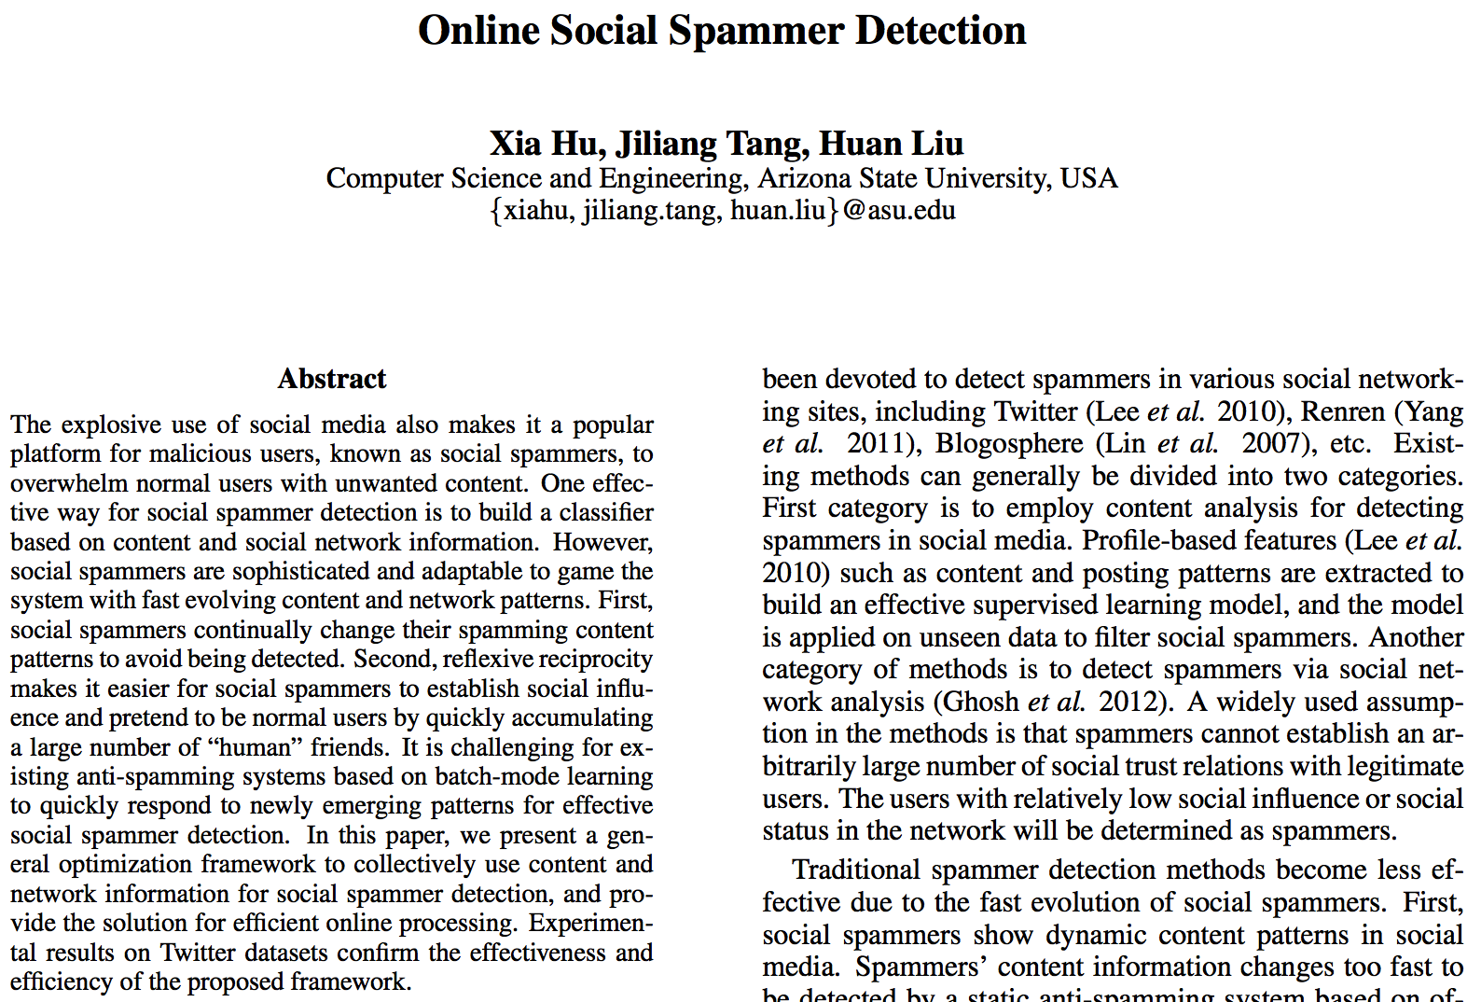
Example: Technology Exploration
AAAI’14
 | Dataset | Problem | Method
Paper-AAAI’06 |  | convex optimization | logistic regression; L1 regularization
Paper-CS229 | netflix | rating prediction | logistic regression; L1 regularization; L2 regularization; matrix factorization
Paper-Computer’09 | netflix | rating prediction | matrix factorization; regularization
Paper-WWW’07 | amazon | review spam detection; classification | logistic regression
Paper-AAAI’12 | renren | social spam detection; classification | matrix factorization
Paper-AAAI’14 | twitter | social spam detection; convex optimization | matrix factorization; regularization

Slide 11
Why Data Mining?
The Explosive Growth of Data: from terabytes to petabytes
Data collection and data availability
Automated data collection tools, database systems, Web, computerized society
Major sources of abundant data
Business: Web, e-commerce, transactions, stocks, …
Science: Remote sensing, bioinformatics, scientific simulation, …
Society and everyone: news, digital cameras, YouTube
We are drowning in data, but starving for knowledge!

Slide 12
What is Data Mining?
Data mining (knowledge discovery from data)
Extraction of interesting (non-trivial, implicit, previously unknown and potentially useful) patterns or knowledge from huge amount of data
Alternative names
Knowledge discovery (mining) in databases (KDD), knowledge extraction, data/pattern analysis, data archeology, data dredging, information harvesting, business intelligence, etc.
Watch out: Is everything “data mining”?

Slide 13






About Me: Data Mining
Dr. Meng Jiang (www.meng-jiang.com)
Visiting Ph.D.
B.S. and Ph.D.
Postdoc Researcher
Assistant Professor
Visiting Researcher
Visiting Researcher

Slide 14
TODO
Official description
Course information (hours, credits)
Prerequisites
Syllabus and schedule
Class time and location
Office hours
Teaching assistant
TA office hours
Piazza
Compass
Course work and grading
Assignments
Exams
Project

Slide 15
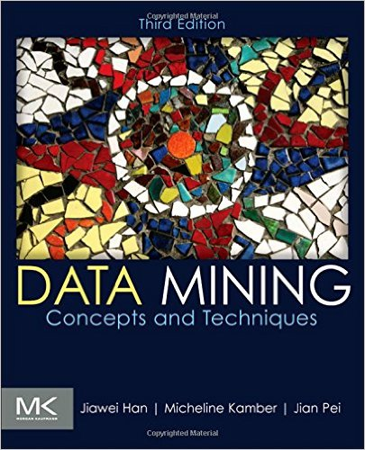
Textbook
Jiawei Han, Micheline Kamber and Jian Pei, Data Mining: Concepts and Techniques (3rd ed), Morgan Kaufmann, 2011

Slide 16
Knowledge Discovery (KDD) Process
Knowledge
Pattern Evaluation
Typical Data Science Study
Data Mining
Task-relevant Data
Data Warehouse
Selection
Data Cleaning
Data Integration
Databases

Slide 17
Example: Web Mining
Web mining usually involves
Data cleaning
Data integration from multiple sources
Warehousing the data
Data cube construction
Data selection for data mining
Data mining
Presentation of the mining results
Patterns and knowledge to be used or stored into knowledge-base

Slide 18
Example: Business Intelligence
Increasing potential
to support
business decisions
End User
Decision Making
Data Presentation
Business
Analyst
Visualization Techniques
Data Mining
Data
Analyst
Information Discovery
Data Exploration
Statistical Summary, Querying, and Reporting
Data Preprocessing/Integration, Data Warehouses
DBA
Data Sources
Paper, Files, Web documents, Scientific experiments, Database Systems

Slide 19
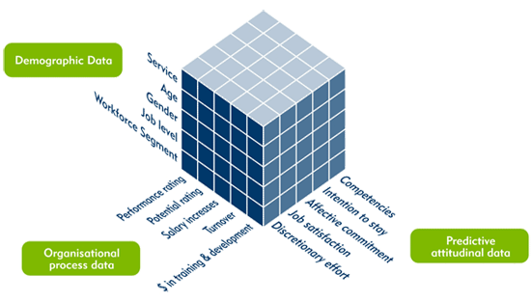
Data Mining Functions: (1) Generalization
Information integration and data warehouse construction
Data cube technology
Multidimensional concept description: Characterization and discrimination

Slide 20
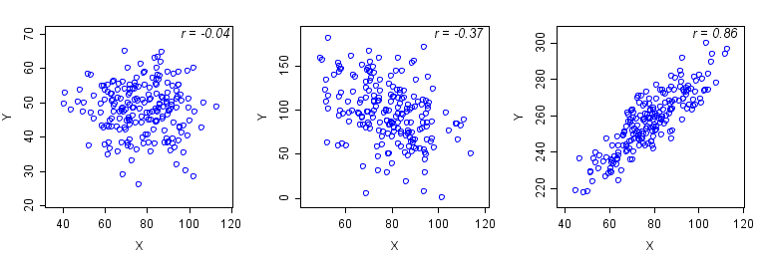
Data Mining Functions: (2) Pattern Discovery
Frequent patterns (or frequent itemsets)
What items are frequently purchased together in your Walmart?
A typical association rule
Diaper → Beer [0.5%, 75%] (support, confidence)
Support: the proportion of transactions in the dataset which contains the itemset (Diaper, Beer).
Confidence: the proportion of the transactions that contains Diaper which also contains Beer.
Association and Correlation Analysis

Slide 21
Data Mining Functions: (3) Classification
Classification and label prediction
Construct models (functions) based on some training examples
Distinguish classes or concepts for future prediction
Ex. 1. Classify countries based on (climate)
Ex. 2. Classify cars based on (gas mileage)
Predict some unknown class labels
Typical methods
Decision trees, naïve Bayesian classification, support vector machines, neural networks, rule-based classification, pattern-based classification, logistic regression, …
Typical applications:
Credit card fraud detection, direct marketing, classifying stars, diseases, web-pages, …

Slide 22
Data Mining Functions: (4) Clustering
Unsupervised learning (i.e., class label is unknown)
Group data to form new categories (i.e., clusters)
Principle: Maximizing intra-cluster similarity & minimizing inter-cluster similarity

Slide 23
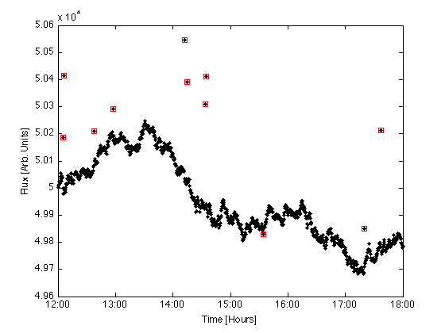
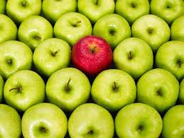
Data Mining Functions: (5) Outlier Analysis
Outlier analysis
Outlier: A data object that does not comply with the general behavior of the data
Methods: by product of clustering or regression analysis…
Useful in fraud detection, rare events analysis

Slide 24
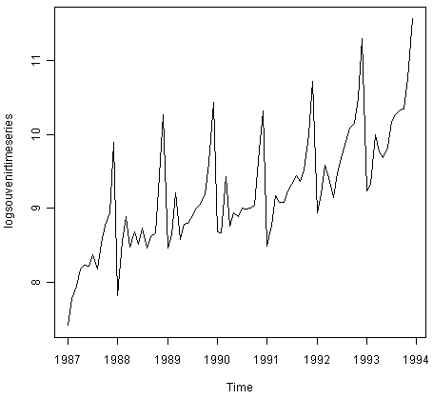
Data Mining Functions: (6) Sequential Pattern, Evolution Analysis
Sequence, trend and evolution analysis
Trend, time-series, and deviation analysis
e.g., regression and value prediction
Sequential pattern mining
e.g., buy digital camera, then buy large memory cards
Periodicity analysis
Motifs and biological sequence analysis
Approximate and consecutive motifs
Similarity-based analysis

Slide 25
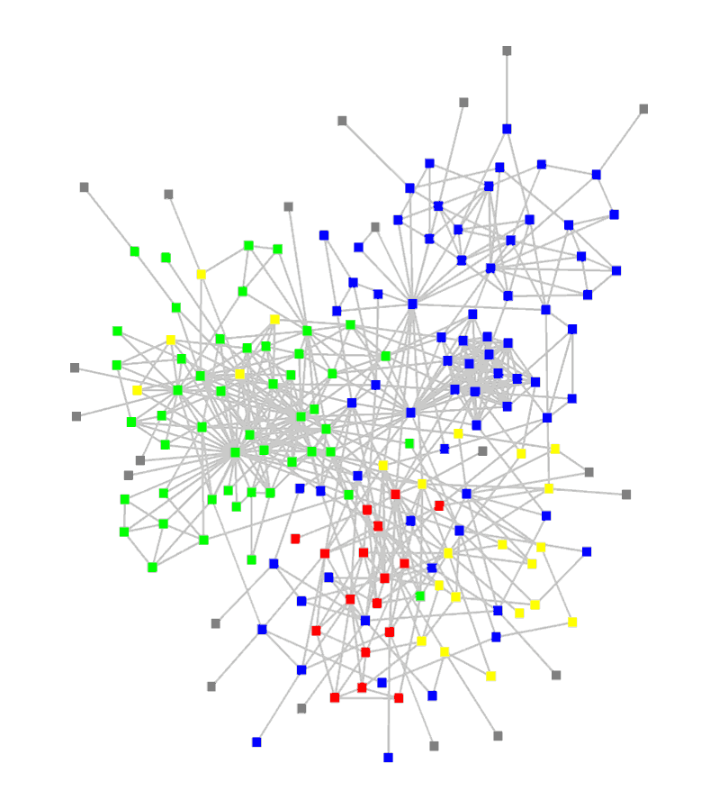
Data Mining Functions: (7) Structure and Network Analysis
Graph mining
Finding frequent subgraphs (e.g., chemical compounds), trees (XML), substructures (web fragments)
Information network analysis
Social networks: actors (objects, nodes) and relationships (edges)
e.g., author networks in CS, terrorist networks
Multiple heterogeneous networks
A person could be multiple information networks: friends, family, classmates, …
Links carry a lot of semantic information: Link mining
Web mining
Web is a big information network: from PageRank to Google
Analysis of Web information networks
Web community discovery, opinion mining, usage mining, …

Slide 26
Applications
Web page analysis: classification, clustering, ranking
Collaborative analysis & recommender systems
Basket data analysis to targeted marketing
Biological and medical data analysis
Data mining and software engineering
Data mining and text analysis
Data mining and social and information network analysis
Scientific knowledge discovery and technology exploration

Slide 27
Syllabus
Introduction
Getting to Know Your Data: Data Description
Getting to Know Your Data: Visualization and Measures
Data Preprocessing: Data Cleaning and Data Integration
Data Preprocessing: Data Reduction and Dimension Reduction
Data Cube: Concepts and Operations
Data Cube: Computation Methods
Data Cube: Data Warehouse and OLAP
Frequent Pattern Mining: Concepts and Apriori
Frequent Pattern Mining: FP-Growth
Frequent Pattern Mining: Pattern Evaluation
Advanced Frequent Pattern Mining: Diverse Patterns and Constraint-based Frequent Pattern Mining
Advanced Frequent Pattern Mining: Sequential Pattern Mining and Graph Pattern Mining
Classification: Concepts and Decision Tree Induction
Classification: Bayesian Classification
Classification: Evaluation and Ensemble
Advanced Classification: Support Vector Machines
Advanced Classification: Neural Networks
Clustering: Concepts
Clustering: Partitioning Methods
Clustering: Kernel-based Clustering
Clustering: Density-based Clustering
Clustering: Evaluation Methods
Outlier Analysis: Concepts
Outlier Analysis: Methods
Lecture: Mining Behavioral Datasets?
Lecture: Mining Text Datasets?

Slide 28
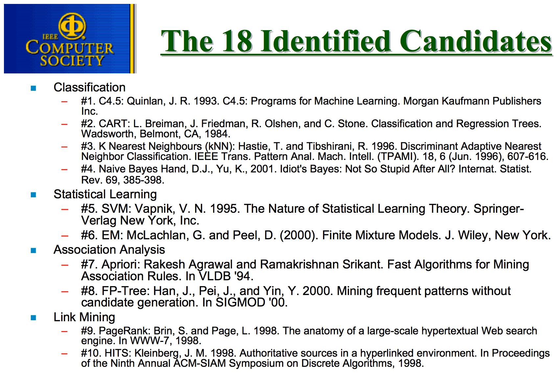
√
√
√
√
√
√

Slide 29
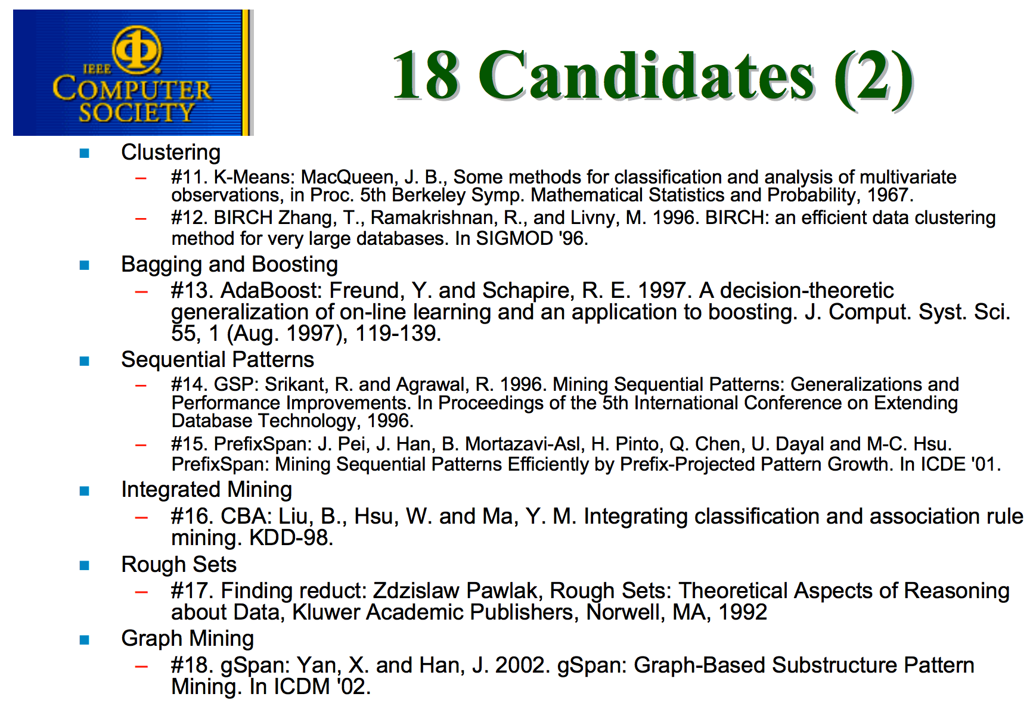
√
√
√
√
√

Slide 30
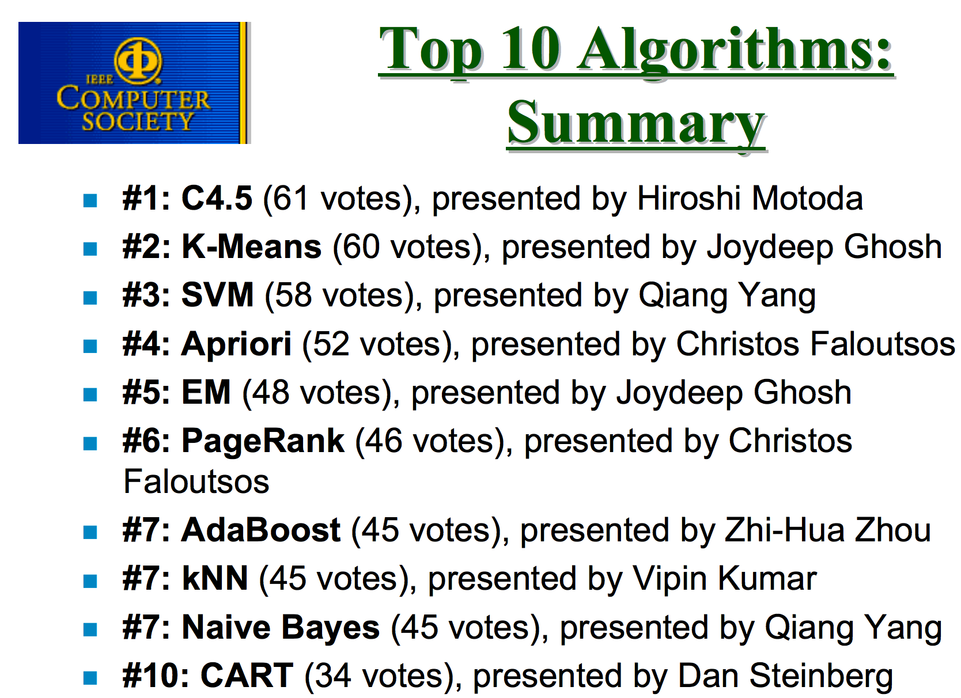
√
√
√
√
√
√
√

Slide 31
History
1989 IJCAI Workshop on Knowledge Discovery in Databases
Knowledge Discovery in Databases (G. Piatetsky-Shapiro and W. Frawley, 1991)
1991-1994 Workshops on Knowledge Discovery in Databases
Advances in Knowledge Discovery and Data Mining (U. Fayyad, G. Piatetsky-Shapiro, P. Smyth, and R. Uthurusamy, 1996)
1995-1998 International Conferences on Knowledge Discovery in Databases and Data Mining (KDD’95-98)
Journal of Data Mining and Knowledge Discovery (1997)
ACM SIGKDD conferences since 1998 and SIGKDD Explorations
More conferences on data mining
PAKDD (1997), PKDD (1997), SIAM Data Mining (2001), (IEEE) ICDM (2001), WSDM (2008), etc.
ACM Transactions on KDD (2007)

Slide 32
Venues
Data mining and KDD (SIGKDD)
Conferences: ACM SIGKDD, IEEE ICDM, SIAM DM, PKDD, PAKDD, etc.
Journal: Data Mining and Knowledge Discovery, KDD Explorations, IEEE TKDE, ACM TKDD
Database systems (SIGMOD)
Conferences: ACM SIGMOD, ACM-PODS, VLDB, IEEE ICDE, EDBT, ICDT, DASFAA
Journals: ACM TODS/TOIS, JIIS, J. ACM, VLDB J., Info. Sys., etc.
AI & Machine Learning
Conferences: ICML, AAAI, IJCAI, COLT (Learning Theory), CVPR, NIPS, etc.
Journals: Machine Learning, Artificial Intelligence, IEEE PAMI, etc.
Web and IR
Conferences: SIGIR, WWW, CIKM, etc.
Journals: Internet and Web Information Systems
Statistics
Conferences: Joint Stat. Meeting, etc.
Journals: Annals of statistics, etc.
Visualization
Conference proceedings: CHI, ACM SIGGraph, etc.
Journals: IEEE Trans. visualization and computer graphics, etc.

Slide 33
Summary
Data mining: Discovering interesting patterns and knowledge from massive amount of data
A natural evolution of science and information technology, in great demand, with wide applications
A KDD process includes data cleaning, data integration, data selection, data mining, pattern evaluation, and knowledge presentation
Data mining functionalities: generalization, association, classification, clustering, trend and outlier analysis, …

Slide 34
Summary
Data mining: Discovering interesting patterns and knowledge from massive amount of data
A natural evolution of science and information technology, in great demand, with wide applications
A KDD process includes data cleaning, data integration, data selection, data mining, pattern evaluation, and knowledge presentation
Data mining functionalities: generalization, association, classification, clustering, trend and outlier analysis, …
What you can expect from this course:
Fundamental data science theories
Basic concepts and methods for mining datasets
Not included:
State-of-the-art machine learning/artificial intelligence algorithms
Full coverage of specific skills that your start-up ideas require

Slide 35
References
Charu C. Aggarwal, Data Mining: The Textbook, Springer, 2015
E. Alpaydin. Introduction to Machine Learning, 2nd ed., MIT Press, 2011
R. O. Duda, P. E. Hart, and D. G. Stork, Pattern Classification, 2ed., Wiley-Interscience, 2000
U. Fayyad, G. Grinstein, and A. Wierse, Information Visualization in Data Mining and Knowledge Discovery, Morgan Kaufmann, 2001
J. Han, M. Kamber, and J. Pei, Data Mining: Concepts and Techniques. Morgan Kaufmann, 3rd ed. , 2011
T. Hastie, R. Tibshirani, and J. Friedman, The Elements of Statistical Learning: Data Mining, Inference, and Prediction, 2nd ed., Springer, 2009
T. M. Mitchell, Machine Learning, McGraw Hill, 1997
P.-N. Tan, M. Steinbach and V. Kumar, Introduction to Data Mining, Wiley, 2005 (2nd ed. 2016)
I. H. Witten and E. Frank, Data Mining: Practical Machine Learning Tools and Techniques with Java Implementations, Morgan Kaufmann, 2nd ed. 2005
Mohammed J. Zaki and Wagner Meira Jr., Data Mining and Analysis: Fundamental Concepts and Algorithms 2014

